Slide 1


Implementing Federal Blockchain In E-Voting:
A Revolutionary Approach to Transparent Voting
Thesis Pre-Defense – Fall 2024
05 May, 2025
Presented by-
Monowar Hossen Sourav - 221002578
MD Sajeeb Mia - 221002251
MD.Naim Ahmmed - 221002599
Supervisors-
Dr. Md Ahsan Habib, Professor
Department of Computer Science and Engineering
Green University of Bangladesh

Slide 2


Table of Contents
Introduction
What is Blockchain?
Blockchain Block Process
Problem Statement
Related Works
Motivation
Objective
Proposed Architecture
Dataflow Diagram
Methodology
Grant Chart
Budget Plan
Conclusion
Reference
01

Slide 3
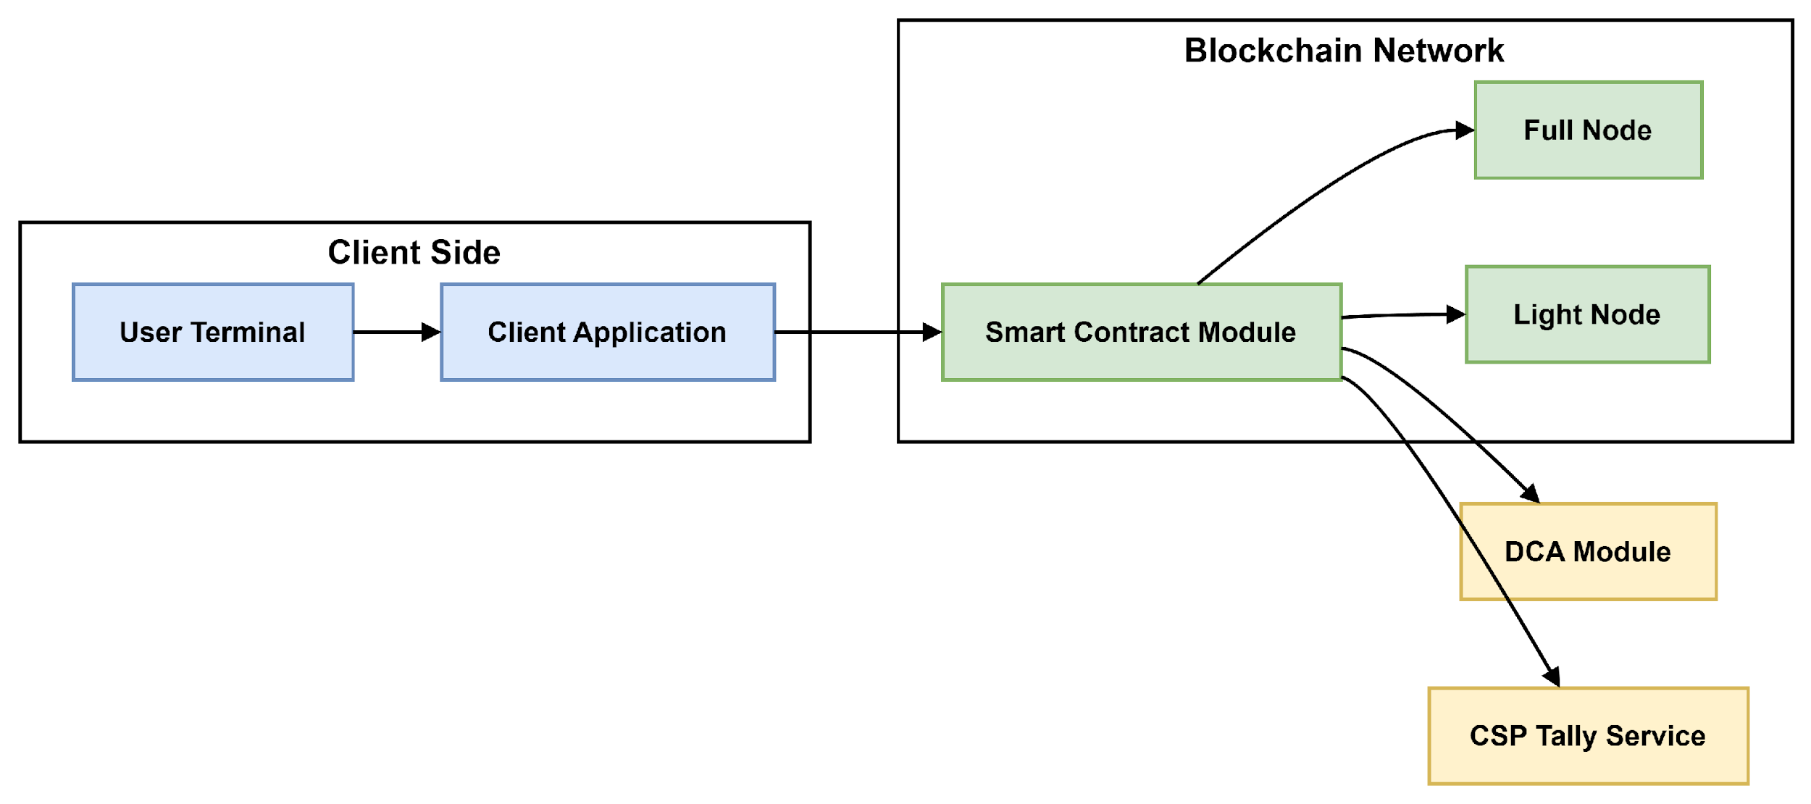
Introduction
E-voting (electronic voting)is the use of electronic systems to cast and count votes in an election.
It allows voters to vote using computers, mobile devices, or electronic machines — either at polling stations or remotely. E-voting can speed up the process, reduce human errors, and provide faster results compared to traditional paper-based voting
Our E-Voting system addresses these issues with live biometric authentication, double-layer security, and efficient secret-sharing tallying. This ensures stronger voter identity, public verifiability, and scalable performance.
02
Figure 1: Component diagram

Slide 4

What is Blockchain?
Block n
A blockchain is a distributed database that maintains a keep-growing list of ordered records called blocks.
Header
Header: Combine all the above elements.
Timestamp: Add block creation time.
Previous Hash: Link with the prior block's hash.
Data: Input transaction or block data.
Hash: Apply SHA-256 to generate a unique block hash.
Nonce: Use for proof-of-work adjustments.
Merkle Root: Summarize all transactions.
Timestamp
Previous Hash
Data
Hash Calculated
Nonce
Merkel Root
03

Slide 5
Blockchain Block Process
Block No. 01
Block No. 02
Block No. 03
Data
Data
Data
Timestamp
Timestamp
Timestamp
Previous Hash:
0000D8C42
Previous Hash:
00003A459
Previous Hash: 0000
…
…
Hash: 0000D8C42
Hash: 00003A459
Hash: 00003D45F
Genesis Block
SHA 256
Function
SHA 256
Function
00003A459
00003D45F
04

Slide 6
Problem Statement
How can we implement real‑time liveness detection for fingerprint and iris enrollment that reliably blocks spoofing without degrading user experience?
What protocol design seamlessly fuses on‑the‑fly biometric verification with ring‑signature proofs to ensure anonymous, unforgeable vote casting?
How can we extend and formally verify blockchain smart contracts to audit hashed biometric templates on‑chain while preserving data confidentiality and integrity?
How do we derive and optimize closed‑form time complexity bounds for each phase of the biometric‑blockchain workflow to guarantee real‑time scalability?
06

Slide 7
Related Work
In Bangladesh and globally, various voting systems have been used, each with its own strengths and limitations:
Traditional Ballot Paper-Based Voting:
Used in national and local elections.
Requires physical presence and manual vote counting.
Limitations:
🔐 Limited Transparency
🖥️ Centralized Architecture
🤔 Public Trust Issues
Electronic Voting Machine(EVM):
Used in some elections to speed up the voting process.
Offers faster results but has faced criticism over transparency and trust.
Centralized systems with limited public auditability.
Limitations:
🕒 Time-Consuming
🧍 Requires Physical Presence:
✋ Prone to Manipulation
💰 High Cost
07

Slide 8
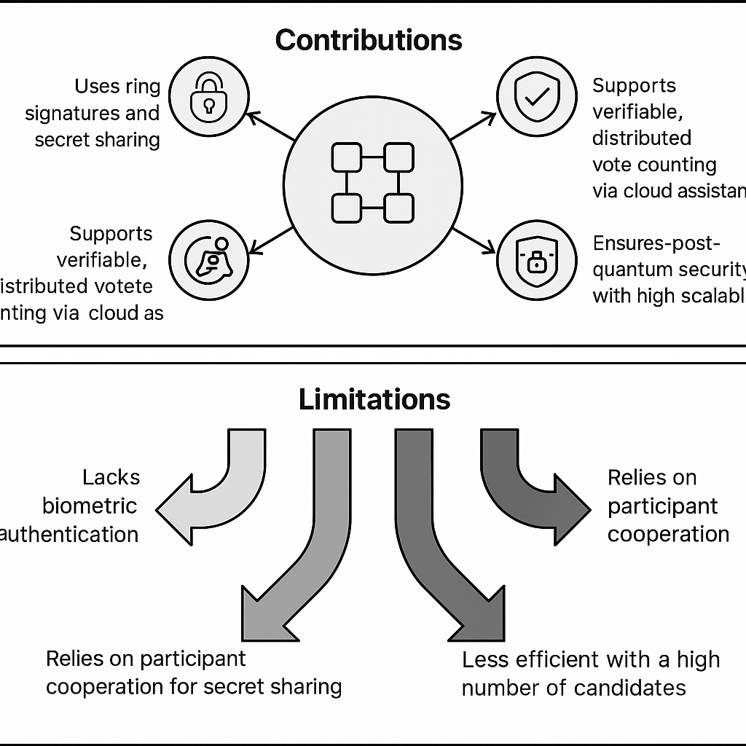
Related Work (1/2)
An Improved Secure and Efficient E-Voting Scheme Based on Blockchain Systems [1]
Introduction: This paper proposes ISE-Voting, a blockchain-based e-voting system designed to enhance security, privacy, and efficiency without relying on a centralized authority.
Contributions:
Uses ring signatures and secret sharing
for secure, anonymous voting.
Supports verifiable, distributed vote
counting via cloud assistance.
Ensures post-quantum security with high
scalability.
Limitations:
Lacks biometric authentication.
Relies on participant cooperation for secret
sharing.
Less efficient with a high number of candidates.
08

Slide 9
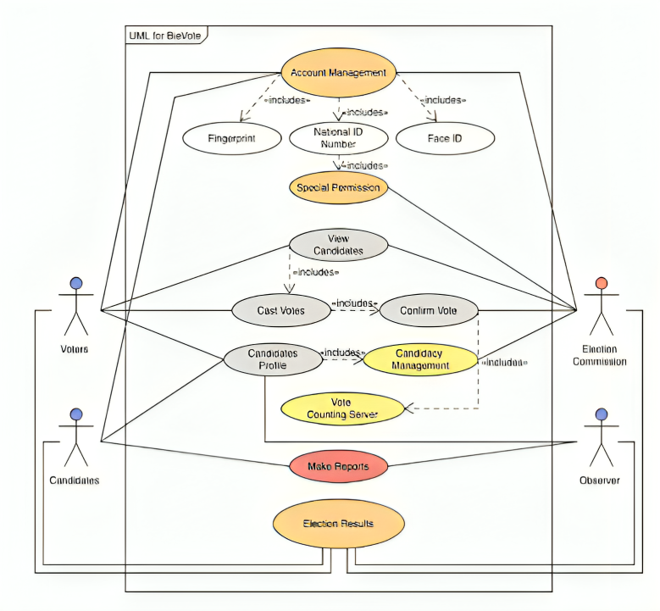
Related Work (2/2)
Transforming online voting: a novel system utilizing blockchain and biometric verification for enhanced security, privacy, and transparency. [2]
Introduction: Proposes a secure online voting system using blockchain and bio-metric verification(face & fingerprint) to improve election security and transparency.
Contributions:
Combines blockchain with bio-metrics for
Secure, verifiable voting.
Uses Hyperledger Fabric for tamper-proof records.
Tested with 100 users; 88% successfully voted.
Limitations:
Needs bio-metric-enabled devices.
Votes can't be changed once cast.
Some bio-metric verification failures.
09

Slide 10
Related Work
Research Name | Contributions | Limitations
An Overview of Joint Bio-metric Identification for Secure Online Voting with Blockchain Technology. [3] | Face and finger check . Encrypted bio-metric data using ECC Secured vote via blockchain. Use OTP for safe login. | Need Device with bio-metric sensor Slight delay in Processing. Complex setup & maintenance. Biometric data privacy concern
Vote Chain: Promising a Secure and Transparent Election using Blockchain and Bio-metrics[4] | Combines bio-metric and blockchain. Use smart contact for vote validation. Reliance against technical failure. | Need bio-metric hardware. False rejection in bio-metric verification Scalability still a concern in very large elections
BP-Vot : Blockchain-Based e-Voting Using Smart Contracts, Differential Privacy, and Self-Sovereign Identities.[5] | Combines blockchain, DP, and SSI. New (k,c)-DP to hide votes. 24% faster,>98% accurate | Slower with many nodes. Need SSI support. Less privacy with 2 candidate. Need trusted ID issuer.
10

Slide 11
Motivation
Single‑Factor Proofing Risk:
Relies solely on DCA‑issued credentials.
Absence of additional identity checks leaves the system vulnerable to impersonation.
Biometric Liveness Integration: Fingerprint and iris modalities verify a voter’s physical presence and Real‑time liveness detection
Double‑Layer Authentication:
Something You Are.
Something You Have.
Scalability Through Complexity Analysis: Establish closed‑form time‑complexity for enrollment, verification, hashing, and on‑chain submission.
11

Slide 12
Objective
To develop liveness‑checked enrollment for fingerprint and iris biometrics.
To specify a double‑layer cast‑time protocol combining biometric and ring‑signature proofs.
To extend and formally verify SC (smart contracts) for secure on‑chain storage and audit of biometric hashes.
To derive closed‑form time complexity bounds for each phase and optimize bottlenecks.
12

Slide 13
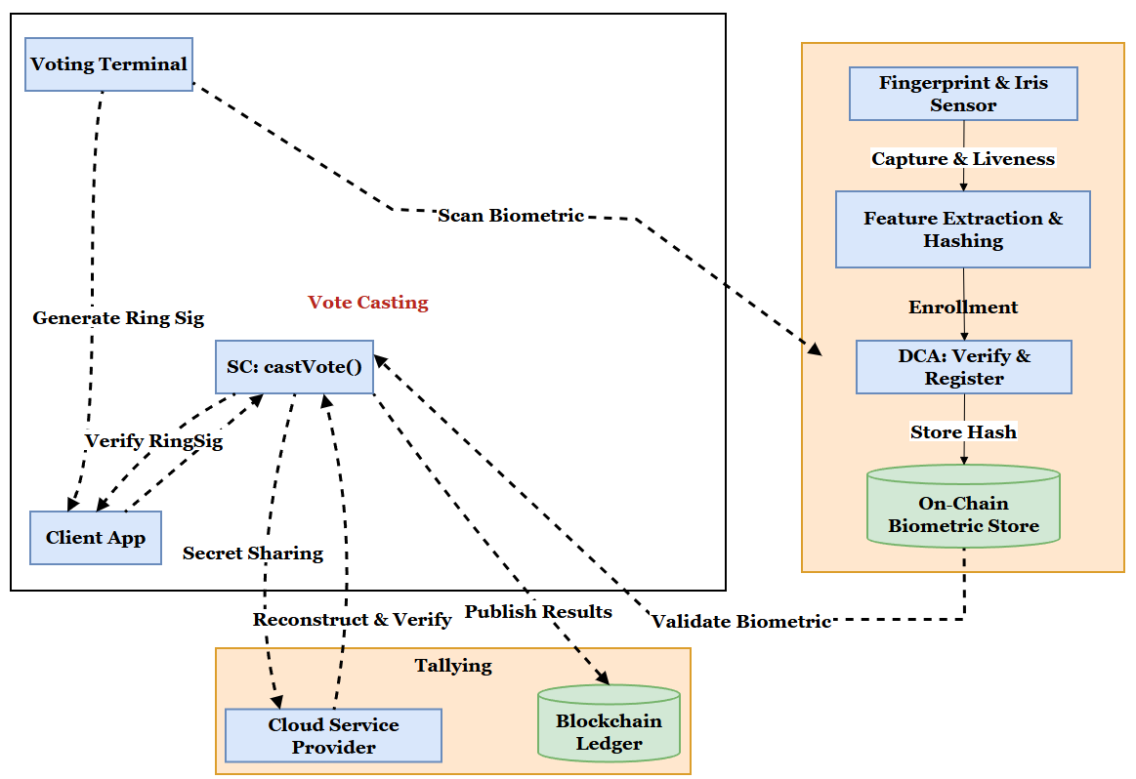
Proposed Architecture
This diagram shows the three operational phases enrollment, vote casting, and ballot tallying highlighting interactions between physical sensors, on‑chain stores, smart contracts, and off‑chain tally services.
13

Slide 14
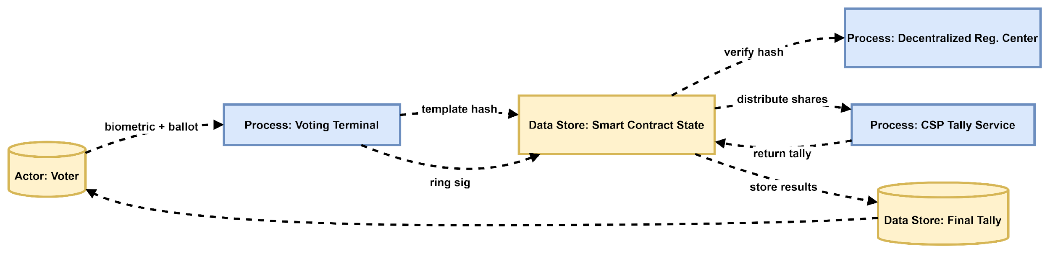
Data Flow Diagram
The DFD clarifies data storage elements and process flows, ensuring each artifact (hash, signature, shares) is accounted for in governance and auditing
14

Slide 15
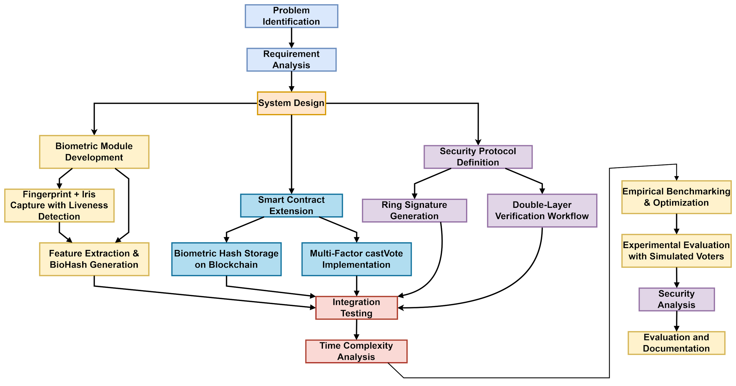
Methodology
15

Slide 16
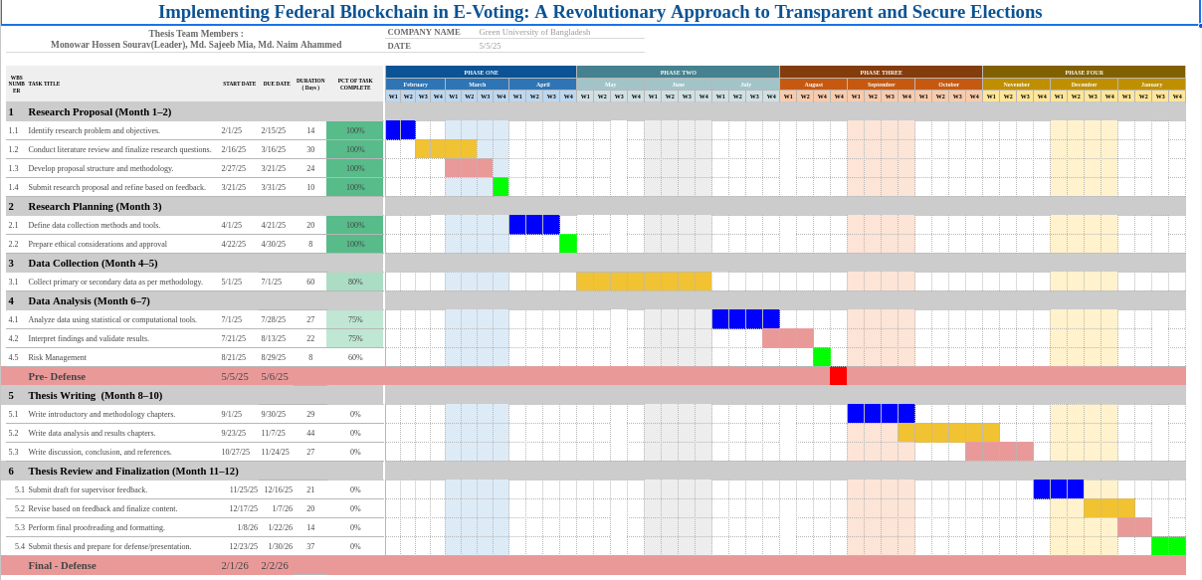
Grant Chart
16

Slide 17
Budget Table
Points | Item | Unit | No. of Unit | Per Unit Cost (Tk) | Duration (Month) | Total Cost (BDT-Tk)
01 | Data Collection | Travel & Testing | 10 | 5,000 | 12 | 50,000
02 | Blockchain Setup | Cloud-based blockchain nodes (AWS / Azure) | 12 | 10,000 | 12 | 1,20,000
03 | Hardware | Laptop & IoT Devices | 2 | 80,000 | ------ | 1,60,000
04 | Publication | Conference / Journal Fees | 2 | --------- | ------ | 1,00,000
05 | Software Tools | Dev Tools ( Colab Pro ) | 12 | 1,500 | 12 | 18,000
06 | Hosting & Domain | Hosting for certificate verification portal | 1 | 12,000 | 12 | 12,000
07 | Miscellaneous | General Expenses (Print) | -------- | 1,000 | 12 | 12,000
Total |  |  |  |  |  | 4,72,000
17

Slide 18
Conclusion
Live biometrics and double-layer verification can be implemented in blockchain-based e-voting systems with tolerable overhead.
Investigating zero-knowledge biometric proofs for enhanced privacy.
Exploring geo-distributed tallies via hierarchical secret sharing for resilience and scalability.
Conducting real-world pilot studies with human subjects to validate the approach in practical scenarios.
20

Slide 19
Reference
[1] An Improved Secure and Efficient E-Voting Scheme Based on Blockchain Systems(2025) DOI: 10.1109/JIOT.2024.3507366
[2] Transforming online voting: a novel system utilizing blockchain and biometric verification for enhanced security, privacy, and transparency.
DOI: 10.1007/s10586-023-04261-x
[3] An Overview of Joint Bio-metric Identification for Secure Online Voting with Blockchain Technology. DOI:10.1109/ICIMIA60377.2023.10426344
[4] VoteChain: Promising a Secure and Transparent Election using Blockchain. DOI:10.1109/ICPECTS62210.2024.10780340
[5] BP-Vot: Blockchain-Based e-Voting Using Smart Contracts, Differential Privacy, and Self-Sovereign Identities. DOI:10.1109/ACCESS.2025.3548404
21

Slide 20
THANK YOU

Slide 21
Any Questions
?

